Slide 1


LOAN
DEFAULTER
DEPI AWS MACHINE LEARNING ENGINEER GRADUATION PRPJECT

Slide 2
Team Members
Maria Ashraf Bestawaros
Islam Abd-elmoniem Ahmad
Sherif Mohamed Mokhtar
Yousra Emad Mohamed

Slide 3
Agenda
Introduction about the problem
Business application
Data explanation and view
Data preprocessing
Feature selection and engineering
Model training
Different Models theory explanation
Testing
Final results
Areas of improvement

Slide 4


PROBLEM STATEMENT
Develop a predictive model to identify and classify potential loan defaulters based on historical customer data and relevant features.

Slide 5
IMPORTANCE
Business Loss
Mitigate two types of risks associated with loans
Money Loss

Slide 6
PROSPECT CLIENTS
Insurance
Companies
Investment
Firms
Banks
Real Estate

Slide 7
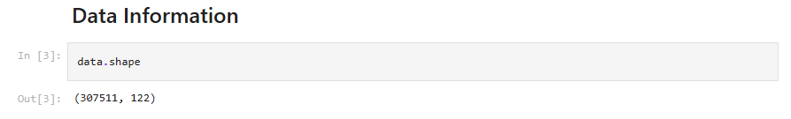
DATASET
Number of Data points: 307511
Each data points has 122 features.

Slide 8
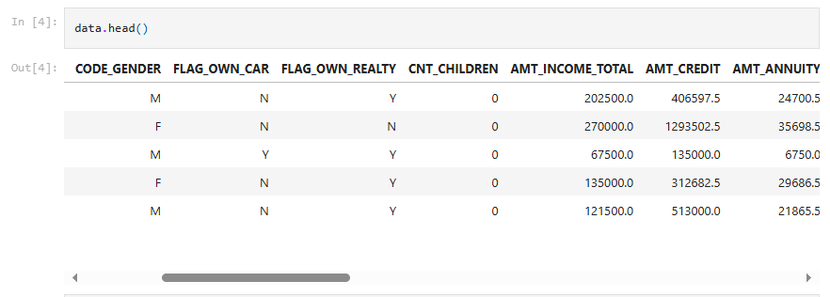
DATASET

Slide 9
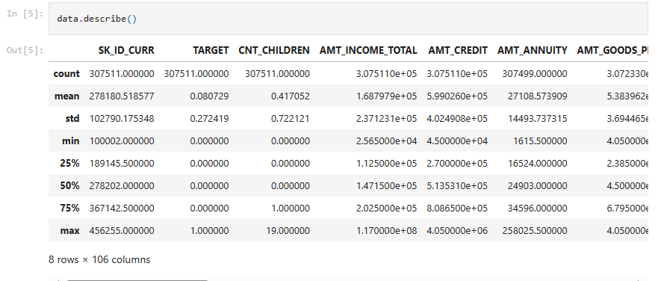
DATASET

Slide 10
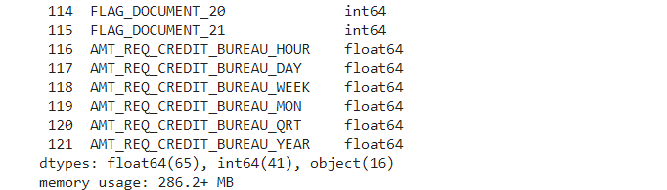
DATASET
data.info(verbose=True)

Slide 11
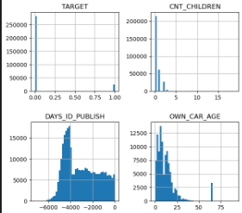
DATA VISUALIZATION
Numerical Data

Slide 12
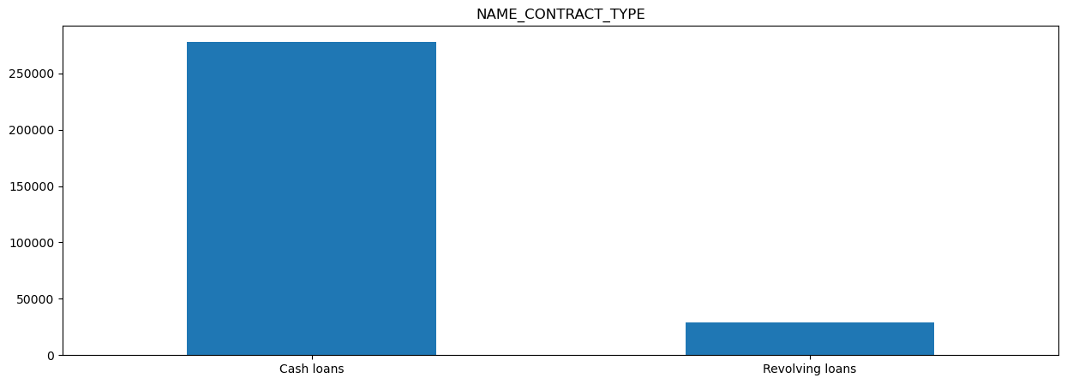
DATA VISUALIZATION
Categorical Data

Slide 13
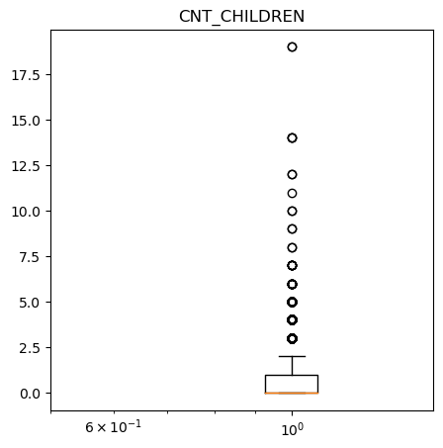
DATA VISUALIZATION
Box Plot

Slide 14
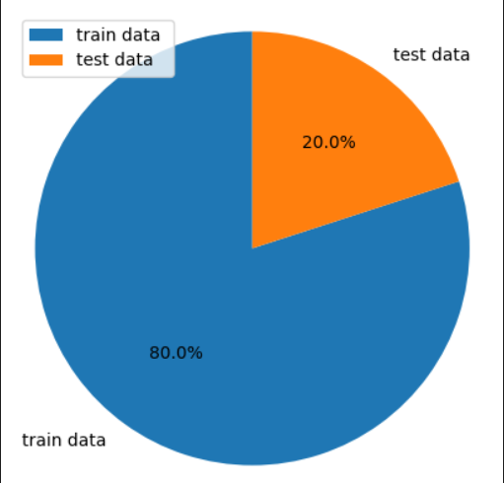
DATA SPLIT
StratifiedShuffleSplit()
split dataset into :
train data ( 80%)
test data (20%)

Slide 15
DATA PREPROCESSING
Missing Data
1

Slide 16
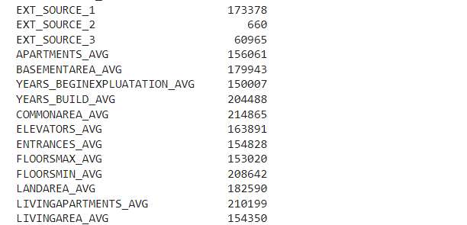
DATA PREPROCESSING
data.isnull().sum()

Slide 17
DATA PREPROCESSING
Impute Data
Missing Data
2
1

Slide 18
DATA PREPROCESSING
SimpleImputer()
For Categorical Columns
imputer_cat = SimpleImputer(strategy='most_frequent')
For Numerical Columns
imputer_num = SimpleImputer(strategy='median')

Slide 19
DATA PREPROCESSING
Encoding
Impute Data
3
Missing Data
2
1

Slide 20
DATA PREPROCESSING
For categorical features, data has to be encoded so the model can be trained on them
OneHotEncoder()

Slide 21
DATA PREPROCESSING
Feature Scaling
Encoding
4
Impute Data
3
Missing Data
2
1

Slide 22
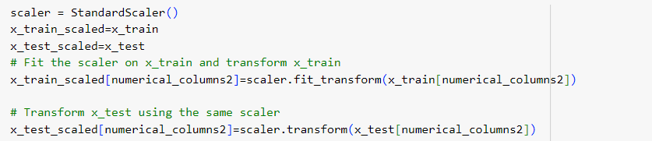
DATA PREPROCESSING
StandardScaler()

Slide 23
DATA PREPROCESSING
Feature Selection and Engineering
Feature Scaling
next stage
Encoding
4
Impute Data
3
Missing Data
2
1

Slide 24
FEATURE SELECTION AND ENGINEERING
Feature Selection:
1-Removing irrelevant features: Example, dropping 'SK_ID_CURR'
2-Using Correlation Matrix

Slide 25
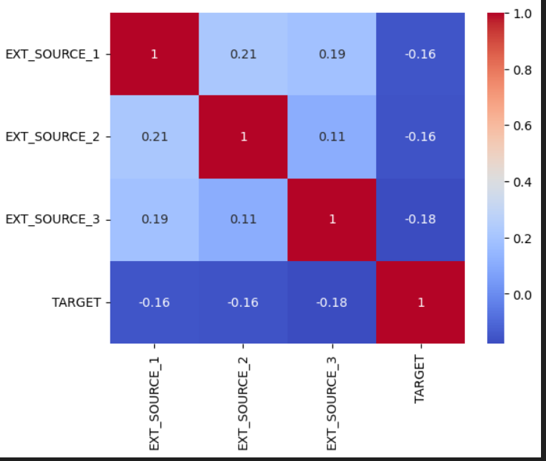
FEATURE SELECTION AND ENGINEERING
Correlation Matrix:

Slide 26
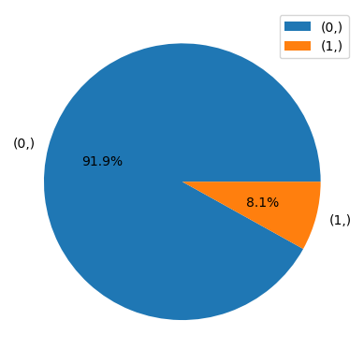
FEATURE SELECTION AND ENGINEERING
Feature Engineering:
-Handling imbalanced in Target
column

Slide 27
FEATURE SELECTION AND ENGINEERING
Feature Engineering:
-Handling imbalance in Target column using SMOTE

Slide 28
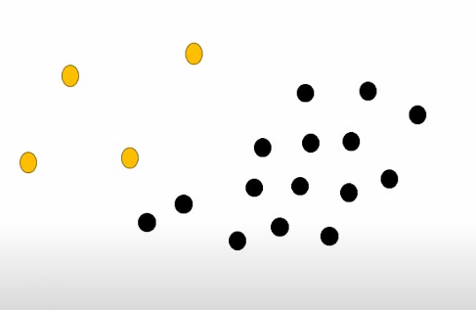
FEATURE SELECTION AND ENGINEERING
SMOTE (Synthetic Minority Over-sampling Technique ):

Slide 29
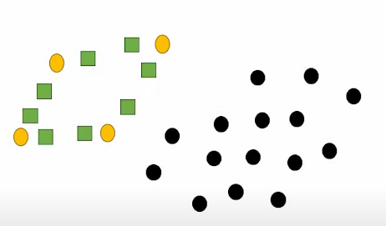
FEATURE SELECTION AND ENGINEERING
SMOTE (Synthetic Minority Over-sampling Technique ):

Slide 30
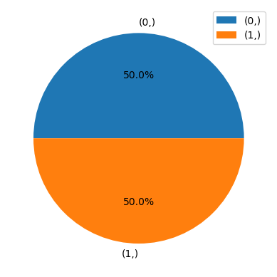
FEATURE SELECTION AND ENGINEERING
Feature Engineering:
-Handling imbalanced in Target
column

Slide 31
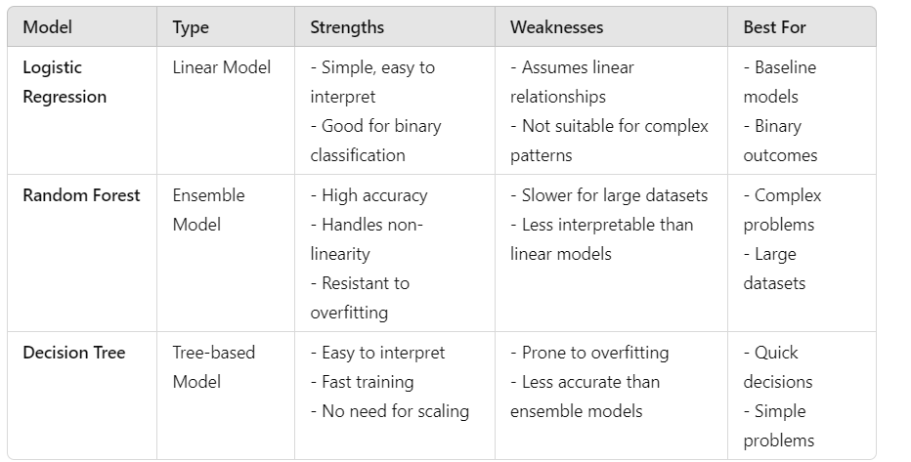
DIFFERENT MODELS THEORY EXPLANATION

Slide 32
MODEL TRAINING
Models Used for training:
Random Forest, Logistic Regression, Decision tree.

Slide 33
MODEL TESTING RESULTS
Evaluation Metrics:
Accuracy, F1-Score, Precision, Recall.

Slide 34
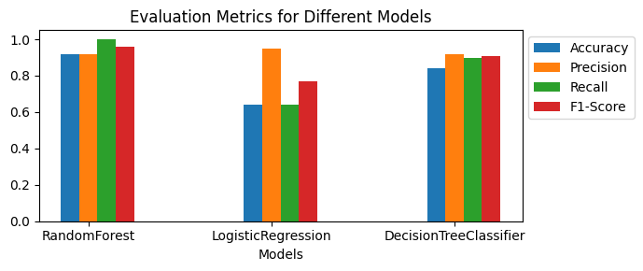
MODEL TESTING RESULTS
Evaluation Metrics:

Slide 35
FINAL RESULTS
Champion Model: Random Forest
Accuracy: 92%
Precision: 91%
Recall: 85%
F1-Score: 88%

Slide 36
MODEL DEPLOYMENT
We have deployed model on streamlit .
We can see a demo now......

Slide 37
AREAS OF IMPROVEMENT
(AWS)

Slide 38
AWS SERVICES
Security and Access Control: AWS IAM
Data Storage : Amazon S3
Data Processing : AWS Glue
Model Training :Amazon SageMaker
Model Deployment : Amazon SageMaker & AWS Lambda
Monitoring : Amazon CloudWatch

Slide 39
Thank you

